Slide 1
Evolution of Solar and Stellar Dynamo Theory
in ‘Solar and Stellar Dynamo: A New Era’ Charbonneau Paul Sokoloff Dmitry

Slide 2
Outline
Introduction to MHD dynamo theory
Paper

Slide 3
Introduction

Slide 4
What is dynamo theory about?
The origin, amplification, saturation and sustainment, of magnetic ﬁelds in the universe
on the Earth, other planets and their satellites (“planetary magnetism”)
in the Sun and other stars (“stellar magnetism”)
in galaxies, clusters and the early universe (“cosmic magnetism”)
If you care about magnetic fields, you might care about dynamo theory.

Slide 5
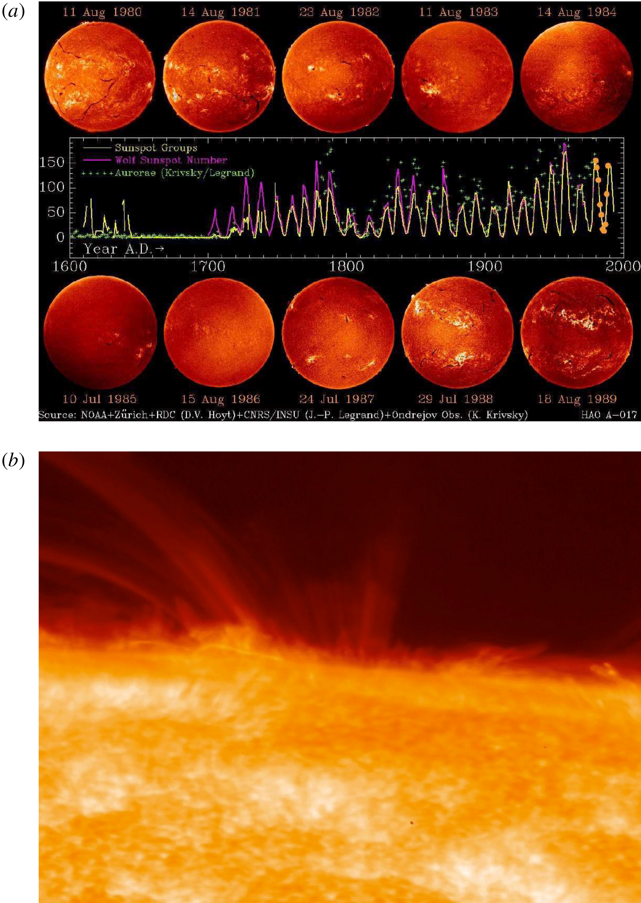
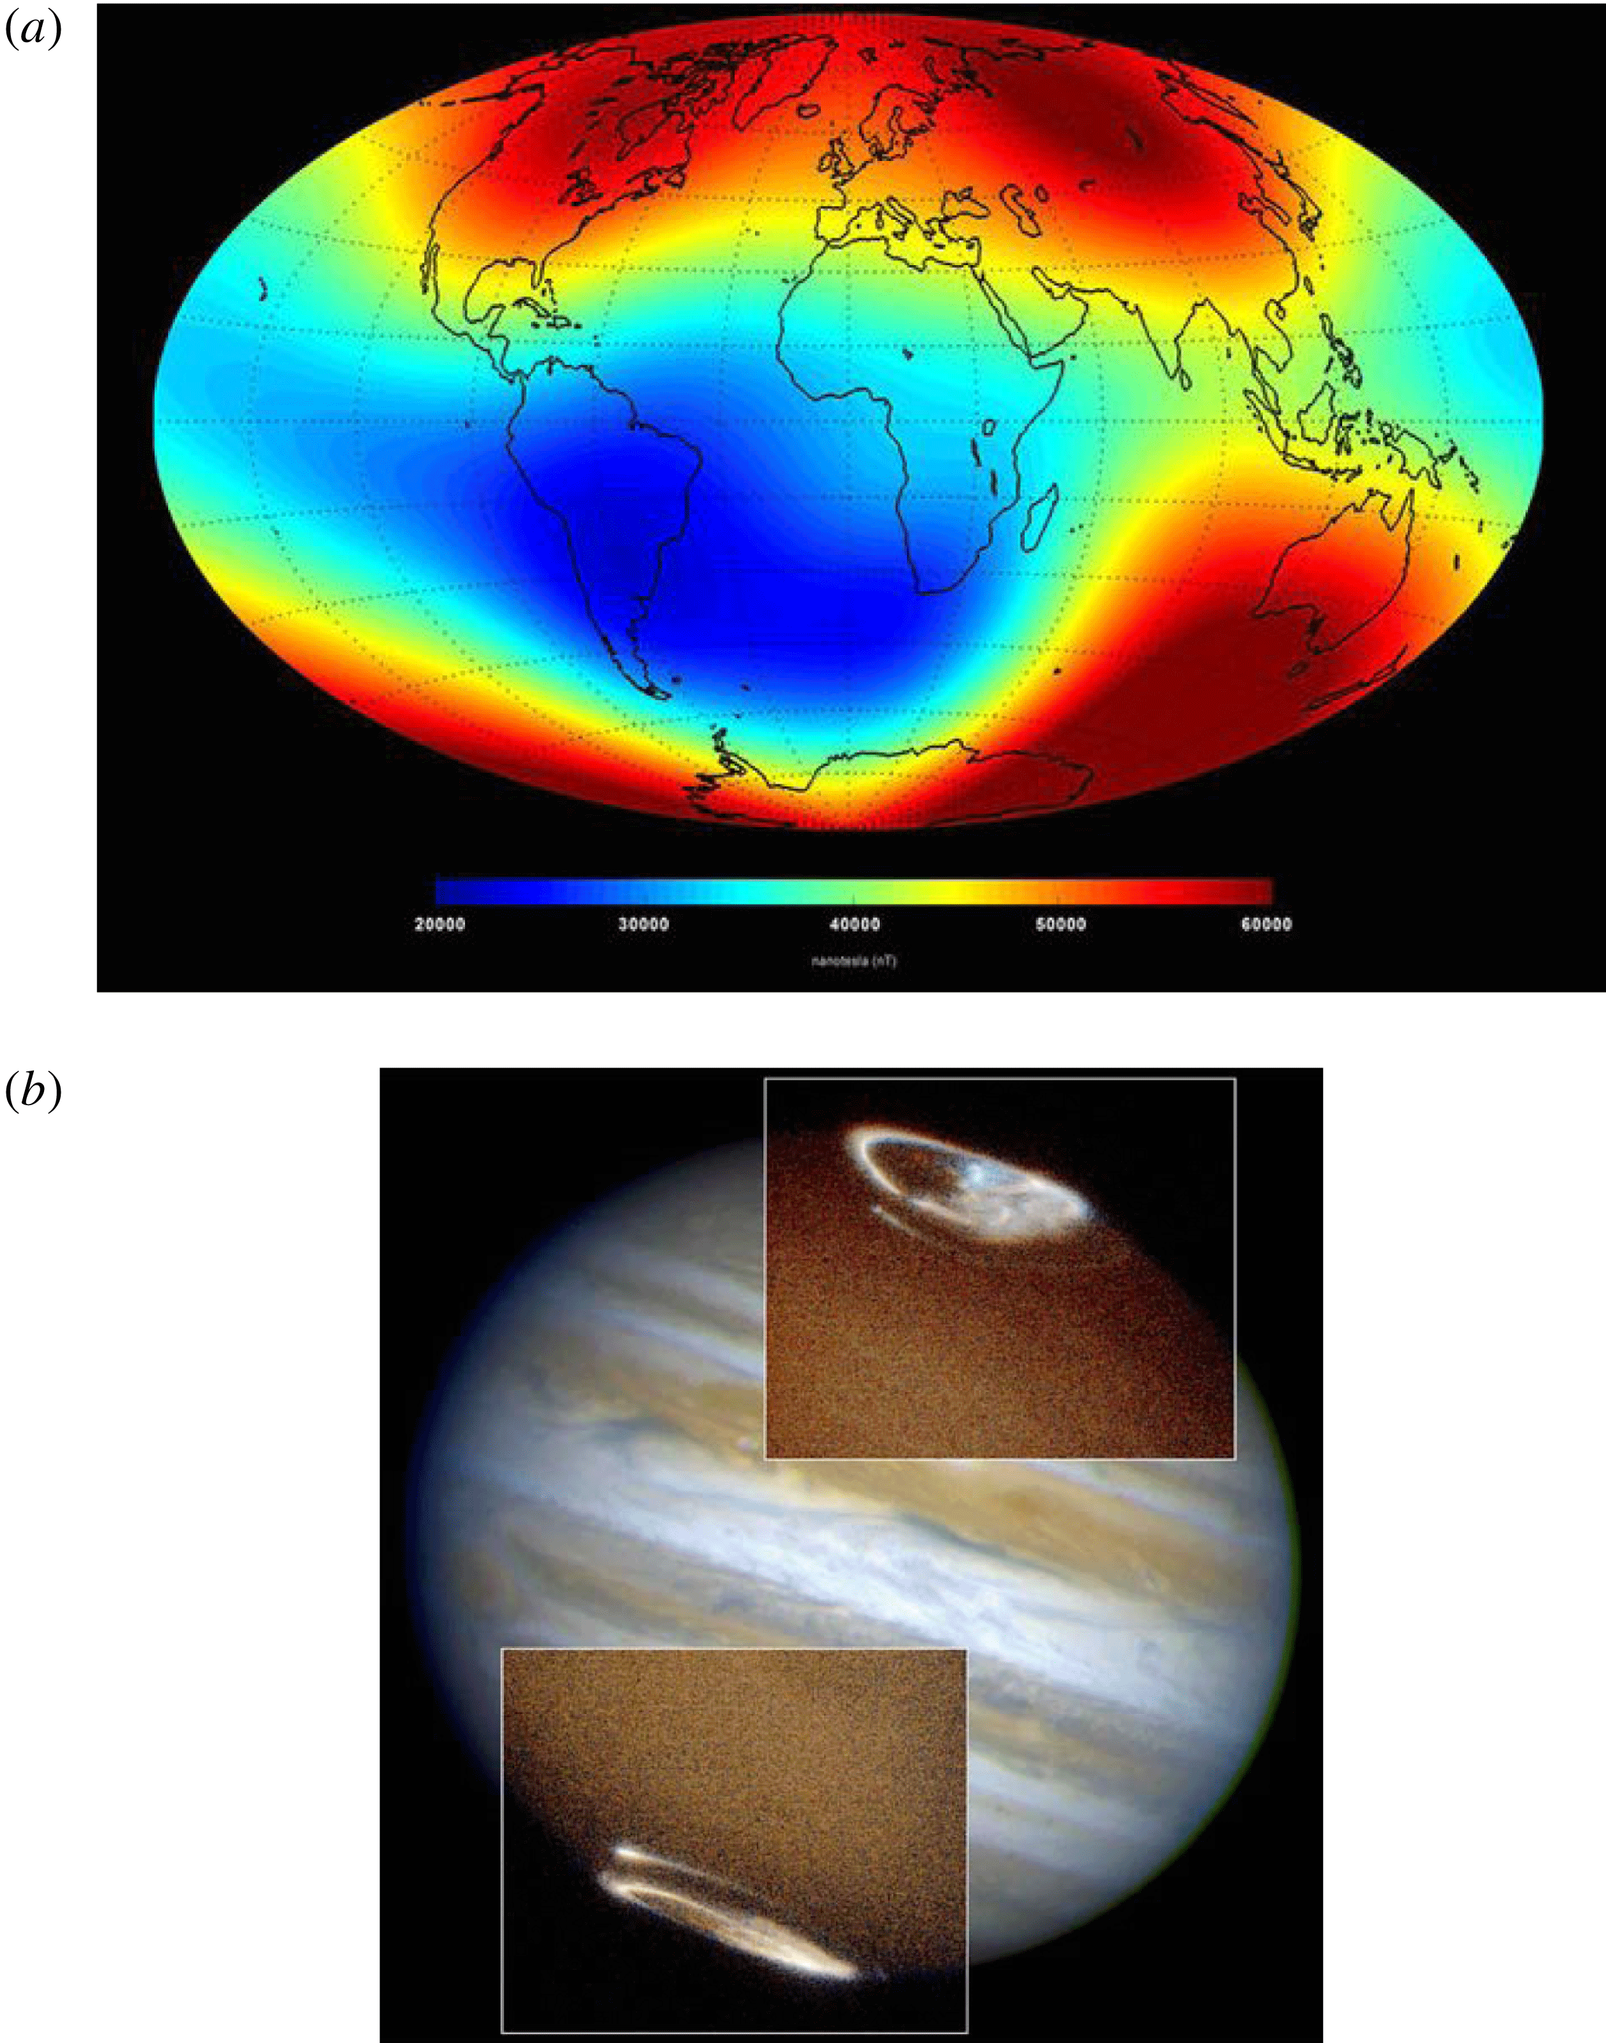
Magnetic ﬁelds in the universe
Solar magnetism (from 1G (global) to 1 kG (sunspots)
Planetary magnetism (0.1 G at Earth’s surface)

Slide 6
Takeaway phenomenological points
Many astrophysical objects have global, ordered ﬁelds
Differential rotation, global symmetries and geometry are important
Coherent structures and MHD instabilities may also be very important
Motivation for the development of “large-scale” dynamo theories
Lots of “small-scale”, random ﬁelds also discovered from the 70s
These come hand in hand with global magnetism
Simultaneous development of “small-scale dynamo” theory
Astrophysical magnetism is in a nonlinear, saturated state
Linear theory not the whole story (or using it requires non-trivial justiﬁcation)
Multiple scale interactions expected to be important

Slide 7
MHD equations
MHD induction equation
$$\frac{∂B}{∂t}=∇×\left(u×B−η∇×B\right)$$
Incompressible, resistive, viscous MHD
$$\frac{∂u}{∂t}+u⋅∇u=−∇P+B⋅∇B+νΔu+f\left(x,t\right)$$
Lenz’s Law
Electromagnetic induction suppresses rather enhances the seed magnetic ﬁeld.

Slide 8
Anti-dynamo theorem
Observations around solar activity minimum suggest that,the large-scale solar magnetic ﬁeld is axisymmetric about the rotation axis.
$$B\left(r,θ,t\right)=∇×\left(A\left(r,θ,t\right){\hat{e}}_{ϕ}\right)+B\left(r,θ,t\right){\hat{e}}_{ϕ}.$$
$$u\left(r,θ\right)=u_{p}\left(r,θ\right)+ϖΩ\left(r,θ\right){\hat{e}}_{ϕ},$$
MHD induction equation
$$\begin{matrix}\frac{∂A}{∂t}=\underset{\text{resistive decay }}{\underset{⏟}{η\left(∇^{2}−\frac{1}{ϖ^{2}}\right)A}}−\underset{\text{transport }}{\underset{⏟}{\frac{u_{p}}{ϖ}⋅∇\left(ϖA\right)}}, \\ \frac{∂B}{∂t}=\underset{\text{resistive decay }}{\underset{⏟}{η\left(∇^{2}−\frac{1}{ϖ^{2}}\right)B+\frac{1}{ϖ}\frac{∂\left(ϖB\right)}{∂r}\frac{∂η}{∂r}}}−\underset{\text{transport }}{\underset{⏟}{ϖu_{p}⋅∇\left(\frac{B}{ϖ}\right)}} \\ −\underset{\text{compression }}{\underset{⏟}{B∇⋅u_{p}}}+\underset{\text{shearing }}{\underset{⏟}{ϖ\left(∇×\left(A{\hat{e}}_{ϕ}\right)\right)⋅∇Ω}}.\end{matrix}$$

Slide 9
Anti-dynamo theorem
Cowling’s theorem
An axisymmetric ﬂow cannot sustain an axisymmetric magnetic ﬁeld against resistive decay.
Zel’dovich’s theorem
Planar, two-dimensional motions cannot excite a dynamo.
Others
A purely toroidal ﬂow cannot excite a dynamo
A magnetic ﬁeld of the form $B\left(x,y,t\right)$ alone cannot be a dynamo ﬁeld.
A minimal geometric complexity is required for dynamos to work.

Slide 10
From toroidal to poloidal
We have no choice but to look for some fundamentally non-axisymmetric process to provide an additional source term in MHD induction equation.
Turbulence and mean-field electrodynamics
The Babcock–Leighton mechanism
Hydrodynamical and magnetohydrodynamical instabilities (from the rotational shear layer, tachocline)

Slide 11
Paper

Slide 12
Tension: Why Is Mean-Field Electrodynamics Working?
Separating the ﬂow and magnetic ﬁeld into large-scale, slowly varying “mean” component $〈U〉,〈B〉$ and small-scale rapidly varying “turbulent” components $u,b$
$$\begin{matrix}U=⟨U⟩+u, \\ B=⟨B⟩+b.\end{matrix}$$
Occasionally interpreted as a decomposition into axisymmetric and non-axisymmetric field components in systems with a rotation axis.
$$\frac{∂⟨B⟩}{∂t}=∇×\left(⟨U⟩×⟨B⟩+ξ−η∇×⟨B⟩\right)$$
where the mean electromotive force $ξ$ is given by the average of the small-scale flow-field cross-correlation:
$$ξ=\left\langle u×b\right\rangle$$

Slide 13
Mean-Field Electrodynamics
Closure is achieved by expanding this turbulent electromotive force (emf) $ξ$ in terms of $⟨B⟩$ and its derivatives:
$$ξ_{i}=a_{ij}\left\langle B_{j}\right\rangle +b_{ijk}\frac{∂\left\langle B_{j}\right\rangle }{∂x_{k}}+⋯$$
This is not a linearization procedure, in that we are not assuming that:
$$\left|u\right|/\left|⟨U⟩\right|≪1$$
$$\left|b\right|/\left|⟨B⟩\right|≪1$$

Slide 14
Tension: Why Is Mean-Field Electrodynamics Working?
The challenge is now to compute these tensorial quantities from known statistical properties of the turbulent ﬂow
Tractable physical regimes:
The energy density of the mean magnetic ﬁeld is larger than the energy density of the small-scale ﬁeld;
The magnetic Reynolds number is low;
The turbulent cyclonic eddies have a lifetime shorter than their characteristic turnover time.

Slide 15
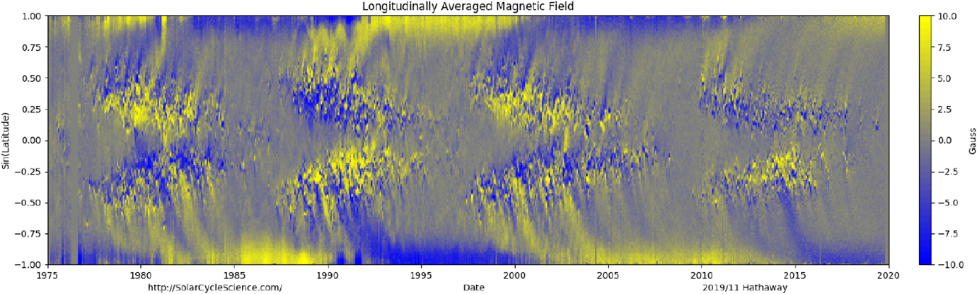
Tension(s): From Solar to Stellar Dynamos
Babcock–Leighton mechanism

Slide 16
The net effect of BMRs is taking a formerly toroidal internal magnetic ﬁeld and converting a fraction of its associated ﬂux into a net surface dipole moment.
Notes:
The larger sunspot pairs (‘‘bipolar magnetic regions’’, hereafter BMR) often emerge with a systematic tilt with respect to the E–W direction, in that on average, the leading sunspot (with respect to the direction of solar rotation) is located at a lower latitude than the trailing sunspot, the more so the higher the latitude of the emerging BMR (see, e.g., Stenﬂo and Kosovichev 2012; McClintock and Norton 2013). This pattern is known as ‘‘Joy’s law’’. The tilt of the magnetic axis of a BMR implies a non-zero projection along the N–S direction, which amounts to a dipole moment. The decay of BMRs and subsequent dispersal of their magnetic ﬂux by surface ﬂows can release a fraction of this dipole moment and contribute to the global dipole.

Slide 17
Tension(s): From Solar to Stellar Dynamos
Hydrodynamical and magnetohydrodynamical instabilities
tachocline
Notes:
The tachocline is the rotational shear layer uncovered by helioseismology immediately beneath the Sun’s convective envelope, providing a smooth match between the latitudinal differential rotation of the envelope, and the rigidly rotating radiative core (see, e.g., Spiegel and Zahn 1992; Brown et al. 1989; Tomczyk et al. 1995; Gough and McIntyre 1998; Charbonneau et al. 1999, and references therein).

Slide 18
Tension(s): From Solar to Stellar Dynamos
Which is the primary polarity reversal mechanism: α-effect, or Babcock–Leighton, . . . or something else?
How do differential rotation and meridional circulation vary with rotation rate, luminosity, and internal structure?
How do turbulent coefﬁcients (α-effect, turbulent pumping, turbulent diffusion) vary with rotation rate, luminosity, and internal structure?
How do sunspots and BMRs form and decay in stars of varying structure (in particularly, depth of convective envelope), rotation rate and luminosity?
Unifying dynamo framework applicable to both the sun and solar type stars of varying spectral type, luminosity, and rotation rate.

Slide 19
References
Tobias, S. M. (2021). The turbulent dynamo. Journal of Fluid Mechanics, 912, P1. 10.1017/jfm.2020.1055
Rincon, François. 2019. “Dynamo Theories.” Journal of Plasma Physics. 10.1017/S0022377819000539.
Rincon, Francois. 2019. “Introduction to MHD Dynamos.” Presentation Link.
Rincon, François. 2017. “Turbulent MHD Dynamos in 2017: A Review of My Own Confusion.”

